Slide 1
Hybrid Legal Search Engine
Combining BM25 with Domain-Adapted LegalBERT

Slide 2
Why a Hybrid Legal Search Engine?
Legal documents contain:
Formal, domain-specific vocabulary
Dense references (e.g., case laws, statutes)
BM25 is:
Fast and interpretable
Lacks semantic understanding
LEGALBERTSMALL is:
Domain-aware and context-sensitive
Computationally intensive on large corpora

Slide 3
Why a Hybrid Legal Search Engine?
Problem: Neither approach alone suffices for real-world legal research.

Slide 4
Why a Hybrid Legal Search Engine?
Problem: Neither approach alone suffices for real-world legal research.
Our Solution: Combine BM25’s speed with LEGALBERT’s semantic depth.

Slide 5
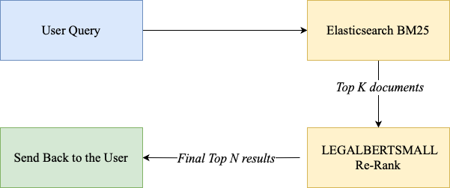
System Architecture

Slide 6
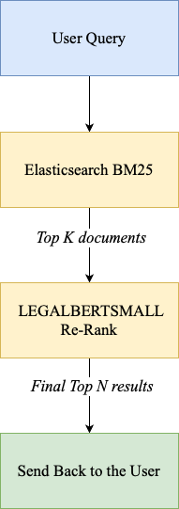
System Architecture
Step 1: Query Handling
User submits a legal query via the UI (FastAPI backend)
Step 2: Initial Retrieval
Query is sent to Elasticsearch
BM25 retrieves top K candidate documents (e.g., Top 100)
Step 3: Semantic Re-Ranking
LEGALBERTSMALL scores and re-ranks the candidates
Outputs top N most relevant documents (e.g., Top 10–20)
Step 4: Response
Re-ranked results are returned to the user interface for exploration

Slide 7
Implementation Stack
Layer | Technology / Tool | Purpose
Search Engine | Elasticsearch (BM25) | Fast keyword-based document retrieval
NLP / Re-Ranking | LEGALBERTSMALL (Hugging Face Transformers) | Semantic scoring of legal documents
API Backend | FastAPI | Lightweight, async request routing
Deployment | Docker, Kubernetes (AWS EKS) | Container orchestration & scaling
Automation | GitHub Actions | CI/CD pipeline for deployment
Cloud Services | AWS (EKS, S3, API Gateway, Elasticsearch) | Hosting, storage, routing, and security

Slide 8
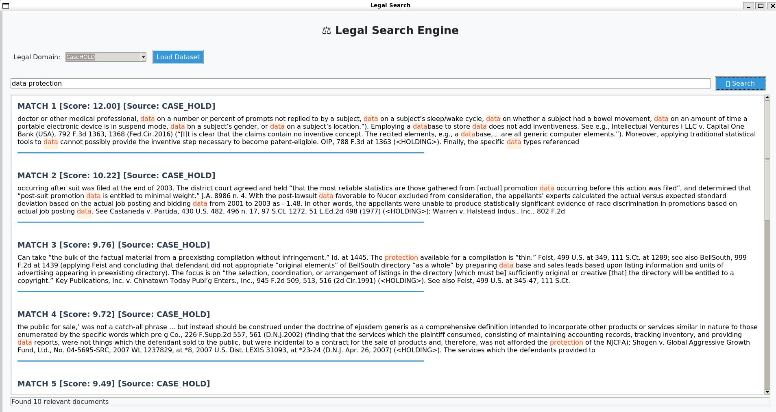
Example Query Output

Slide 9
Example Query Output
Query Submitted: “data protection”
System Response:
Rank | Document Snippet Summary | Score
1 | Discusses lack of inventiveness in storing different types of data — OIP, 788 F.3d 1363 | 12.00
2 | Promotion statistics, discrimination in hiring, mentions data multiple times — Castaneda v. Partida | 10.22
3 | Case on copyright and use of directory data — Key Publications, 945 F.2d 509 | 9.76
4 | Legal interpretation of service data reports and consumer protection — Shogen v. Global Aggressive Growth | 9.72
(Source: CASE_HOLD dataset. Snippets reflect LEGALBERT re-ranking.)
All results are re-ranked — no raw BM25 output is exposed

Slide 10
Qualitative Evaluation & Observations
Our current implementation outputs only final ranked results — no ground-truth labels or automatic relevance metrics
Aspect | Observation
Relevance | Final results are more context-aware than BM25 alone
Legal Semantics | Re-ranked output captures nuance and meaning
User Interaction | Designed for exploratory research, not just keyword search
Performance | Response time remains usable with reranking

Slide 11
Key Strengths & Future Plans
Shallow keyword search: LEGALBERTSMALL for semantic re-ranking
Complex legal vocabulary: Domain-adapted transformer embeddings
Speed vs accuracy trade-off: BM25 for speed + LEGALBERT for precision
Usability: Simple interface with fast, interpretable results
We plan to build on this foundation by introducing measurable evaluations, explainability features, and expanding to new legal domains and languages.

